Slide 1
AWS Networking Workshop
Easily interconnect on premise networks and VPCs at scale

Slide 2
Agenda
What will do today? -15 minutes
What is Transit Gateway? – 20 min
What is AWS Route53 Resolver? – 20 min
Building our cloud networking workshop -3 hrs

Slide 3
Scenario
Exisiting Datacenter we want to connect to AWS VPCs
Multiple Environments: Development, Test, Production
Shared resource for above environments: like NAT gateway
Require Integrated DNS between Datacenter and AWS VPC

Slide 4
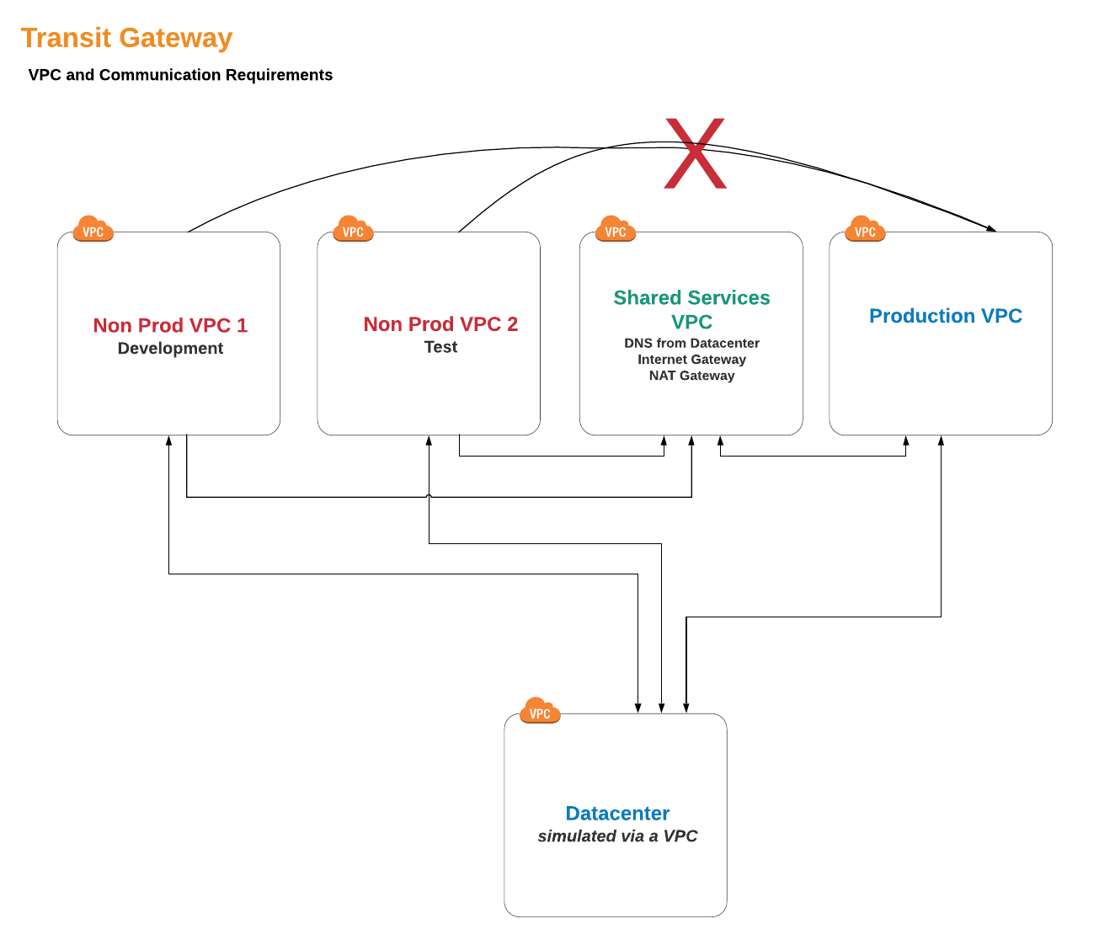

Slide 5
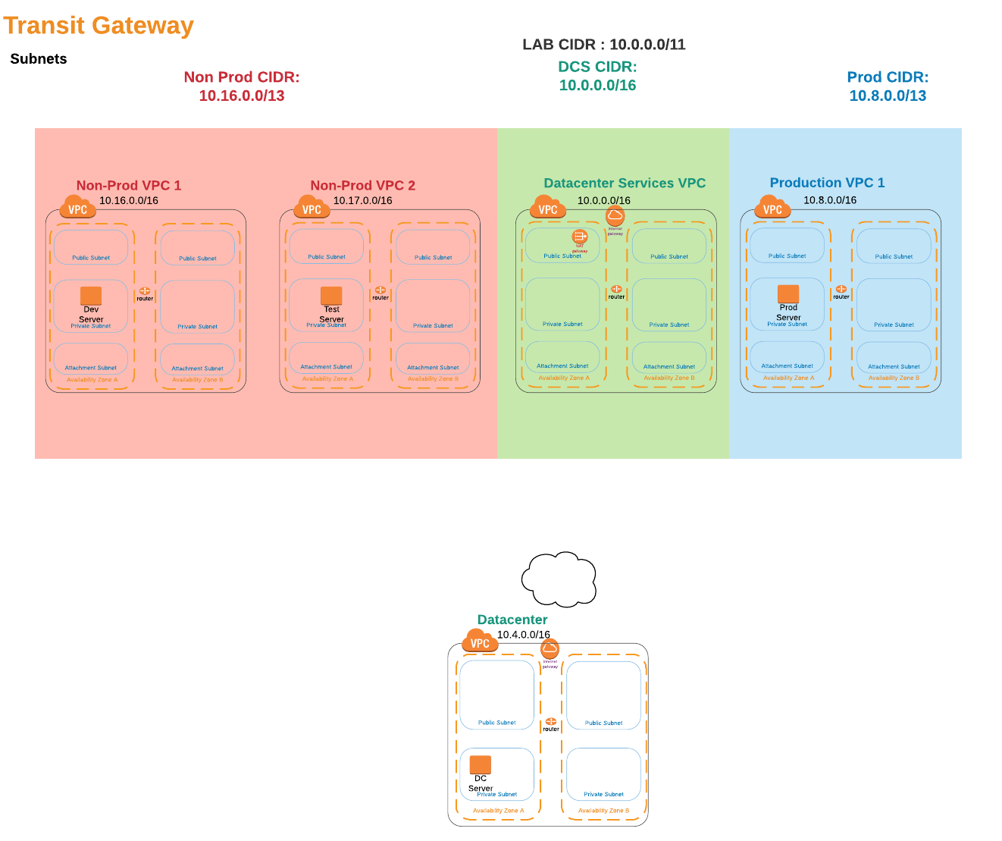

Slide 6
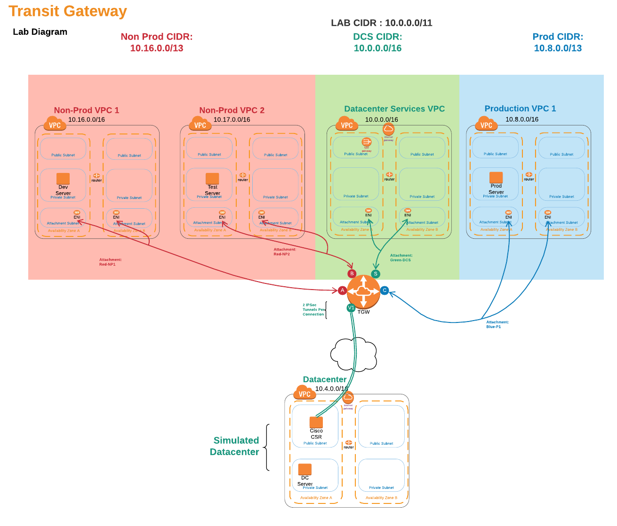

Slide 7
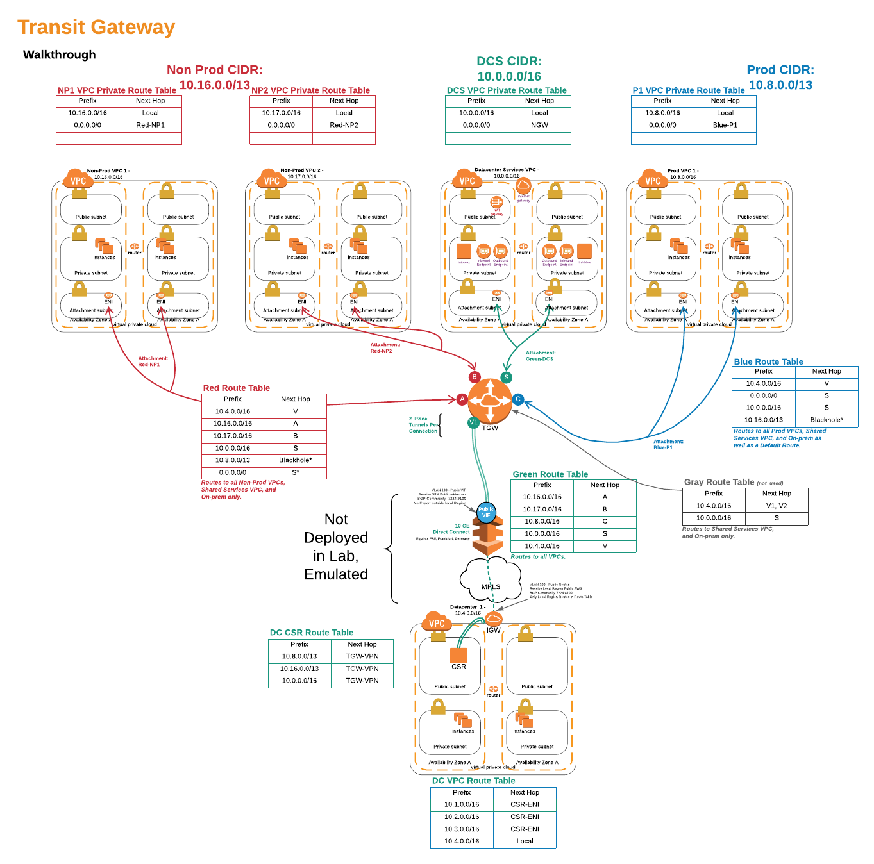

Slide 8
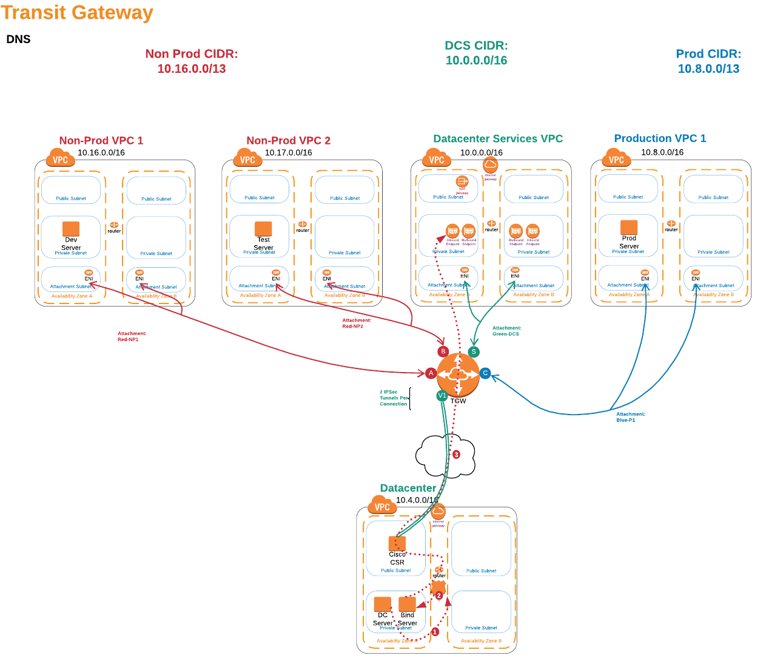

Slide 9
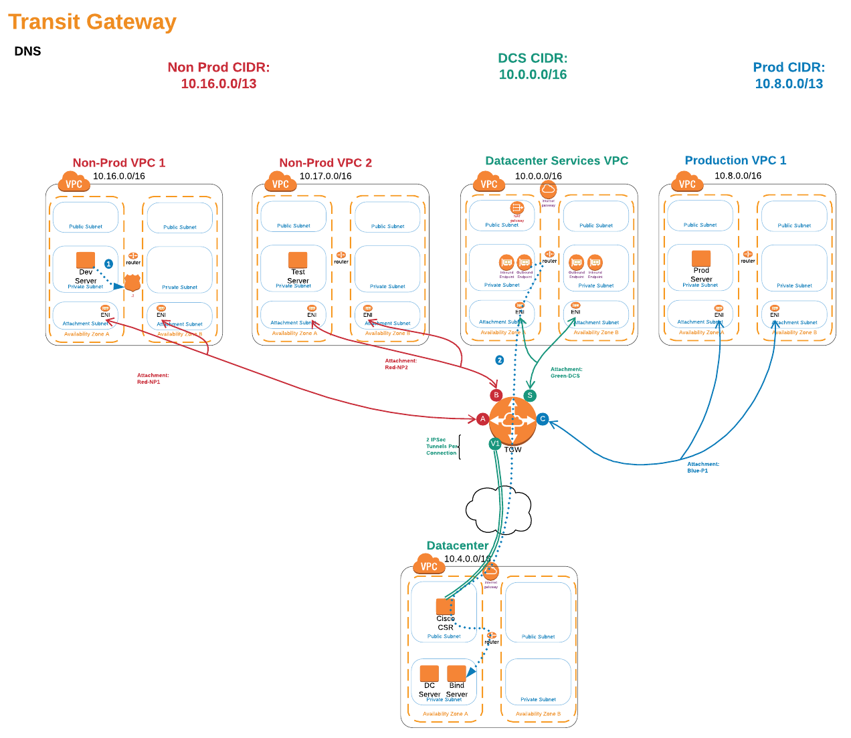

Slide 10
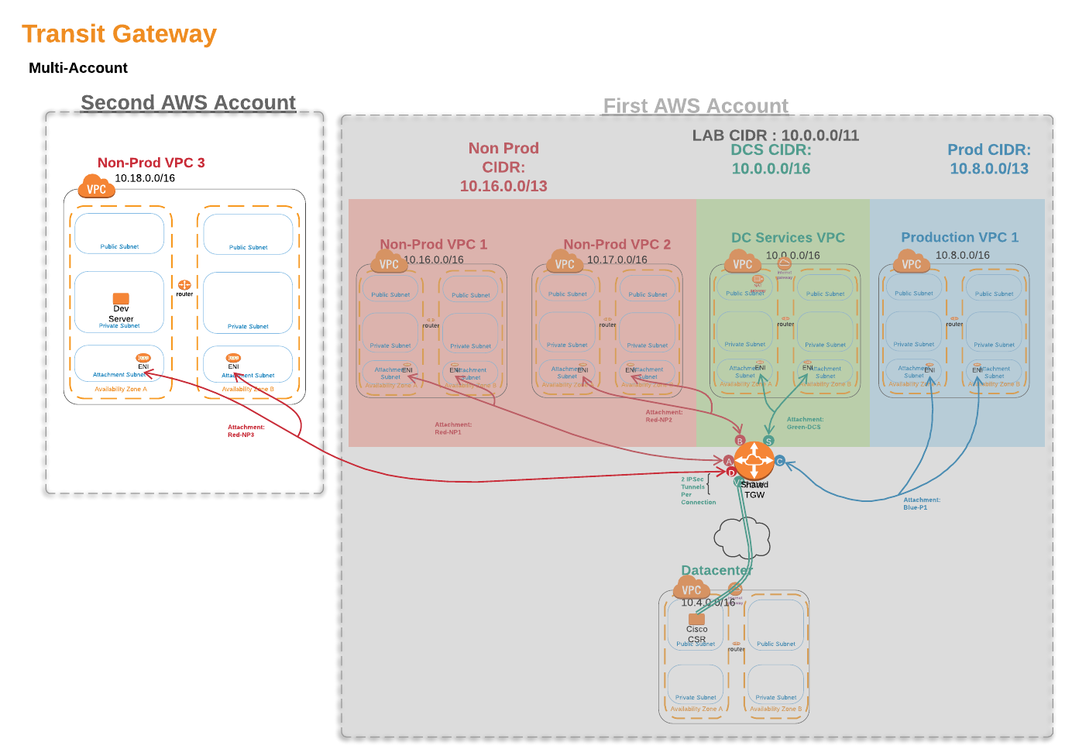

Slide 11
AWS Transit Gateway

Slide 12

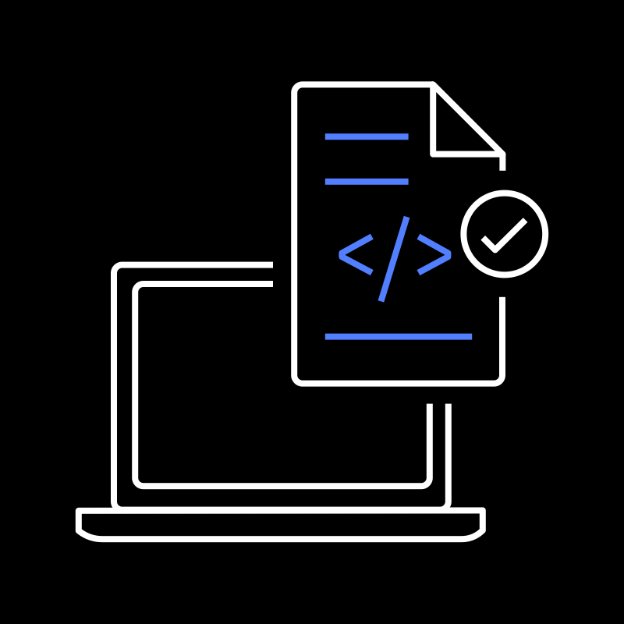
What do customers want to do?
Interconnect VPCs and their on-prem networks
Globally scale out connectivity across regions
Simplify network configuration

Slide 13
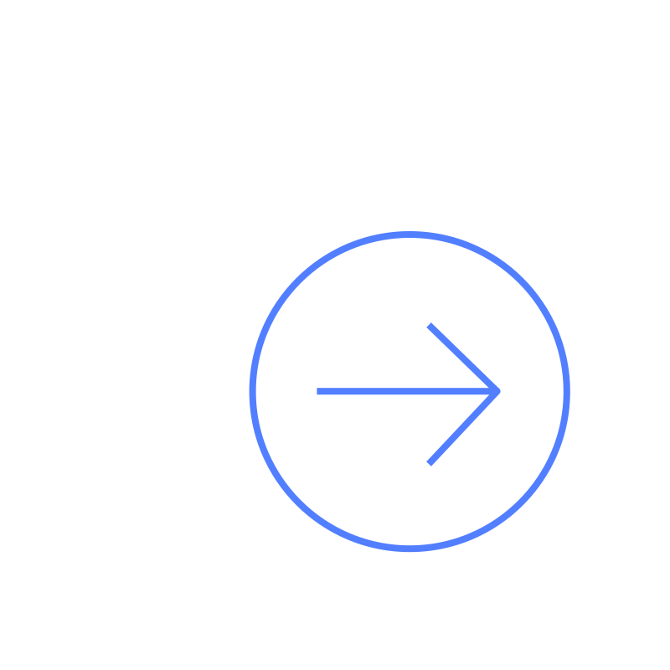
What challenges are they facing?
Complex point-to-point peering does not scale
VPN Bandwidth limitations
Monitoring and Management of routing configurations is time consuming

Slide 14




Introducing AWS Transit Gateway
Easily interconnect thousands of VPCs and on-premise networks
AWS Transit Gateway
On-Premise Data Center
AWS VPC

Slide 15
AWS Transit Gateway: Key features
Centralized routing polices across VPCs and on-prem
Scales to support thousands of VPCs across multi-accounts
AWS Transit Gateway
Increase connectivity throughput with multi-vpn connections
Flexible segmentation and routing rules
Horizontally scalable
Simplified management

Slide 16
AWS Transit Gateway: Benefits
 | Centrally interconnect multiple VPCs across accounts One central connection point for VPN and Direct Connect Reduce or eliminate need for peer to peer networking Increase VPN throughput via ECMP routing (50 Gbps+)
 | Peer AWS Transit Gateway across regions Leverage the AWS Global Network for low latency cross-region connectivity Regional construct reduces blast radius
 | Reduces time to configure on premise connectivity to AWS Easily monitor and manage from a central point Integrated with CloudWatch and VPC Flow Logs Leverage existing VPC security groups and network access control lists
Simplified Networking
Global Connectivity
Easy manageability
Notes:
ECMP = Equal-Cost Multi-Path Routing

Slide 17
Use Case – Interconnecting Geographically Dispersed On-Premise and VPC resources
Customer with multiple VPCs
Build applications that span a large number of VPCs
Share network services (DNS, Active Directory, FW, IDS)
Reduce management overhead
Notes:
AWS Global Accelerator provides a single set of Anycast IP addresses that are globally accessible from our edge locations and provides fine grained controls to optimize routing decisions during application maintennace

Slide 18
Use Case – Edge Consolidation
Share a common VPN or Direct Connect Gateway (DXGW) across all VPCs
Reduce time to connect on premise resources to multiple VPCs
No additional customer network changes required when adding a VPC to AWS Transit Gateway
Notes:
AWS Global Accelerator provides a single set of Anycast IP addresses that are globally accessible from our edge locations and provides fine grained controls to optimize routing decisions during application maintennace

Slide 19
Use Case – Digital security and threat intelligence
Shared VPC hosts security tools
Firewall as a service
Web application Firewall (WAF), Data Loss Prevention (DLP), Intrusion Detection / Protection (IDS/IPS),
Scales out over native AWS Service

Slide 20
How Does It Work

Slide 21
AWS Transit Gateway Reference Architecture
Administrative accounts (logging, AWS Organizations, billing, landing zone)
Account
Account
Account
Account
IAM, Cross-account roles
Development
Testing
Production
Shared services
Account
Account
Account
Account
Account
Account
Outbound
Account
Account
Account
Account
Account
Account
Authentication, Monitoring
URL filtering
NAT gateway
DLP / Proxy
Inline services
Internet
Route tables
Route tables
Edge services
IDS / IPS
Transit Gateway
East-West + North-South
Firewall / NGFW
WAF / ADC
SD-WAN
VPN / Firewall
AWS Direct Connect *
VPN
Available Q1 2019

Slide 22
Shared Services with AWS Transit Gateway
Acquisition
Development
Testing
Production
Shared services
Account
Account
Account
Account
Account
Account
Account
Account
Account
Account
Account
Account
Account
Account
Account
Account
Authentication, monitoring
Extensible for many VPCs if needed
Example applications
Authentication
Logging
DevOps tools
Security resources
Route tables
Route tables
Transit Gateway
Works with flat or isolated segmentation

Slide 23


Using AWS Transit Gateway and PrivateLink
AWS PrivateLink
AWS Transit Gateway
One-to-many connectivity
Highly scalable
Supports overlapping CIDRs
Uses Elastic Load Balancing
Load balancing and hourly endpoint costs
Many-to-Many or one-to-many with route tables
Highly scalable
Hourly per AZ endpoint costs
Development
Testing
Production
Shared Services
Account
Account
Account
Account
Account
Account
Authentication, Monitoring
Account
Account
Account
Account
Account
Account
Route Tables
Route Tables
Transit Gateway
Scope: Application shared services
Trust model: No mutual trust
Dependencies: Load balancing and application architecture
Scale: Thousands of spoke VPCs
Scope: Network shared services to many VPCs
Trust model: Per VPC trust, centralized control
Dependencies: Centralized control of the Transit Gateway
Scale: Thousands of spoke VPCs

Slide 24
VPN With Transit Gateway
Consolidate VPN at the Transit Gateway (TGW)
VPN acts similar to the Virtual Private Gateway (VGW)
Bandwidth, configuration, APIs, cost, and experience
VPN is attached to a TGW instead of a VGW
Same 1.25 gbps bandwidth per tunnel applies
Encryption to the edge of many VPCs
Traffic is encrypted until it’s inside the VPC
Does not natively encrypt traffic between VPCs
Inter-region VPC peering does
Route tables
Route tables
Transit Gateway
VPN
Customer Gateway

Slide 25
VPN with Transit Gateway: Add more bandwidth
Support for spreading traffic across many tunnels
Equal Cost Multi-Path (ECMP) support with BGP multi-path
Tested up to 50 Gbps of traffic
Split traffic into smaller flows, multi-part uploads, etc.
Route tables
Route tables
Transit Gateway
VPN
Check your on-premises configuration
Multi-path BGP
ECMP support, amount of equal paths, reverse-path forwarding/spoofing checks
Only supported with BGP, not static routing
Customer Gateway

Slide 26

AWS Direct Connect and Transit Gateway
Use Direct Connect in parallel
Use VPN over a Direct Connect public virtual interface (VIF)
Development
Testing
Production
Shared Services
AWS Cloud
Account
Account
Account
Account
Account
Account
Account
Account
Account
Account
Account
Account
Route Tables
Route Tables
Transit Gateway
Route Tables
Route Tables
Private virtual interfaces
Receive AWS public IP addresses
Transit Gateway
VPN
Public virtual interface
VPN
AWS Direct Connect
AWS Direct Connect
Native Direct Connect support planned for Q1 2019

Slide 27
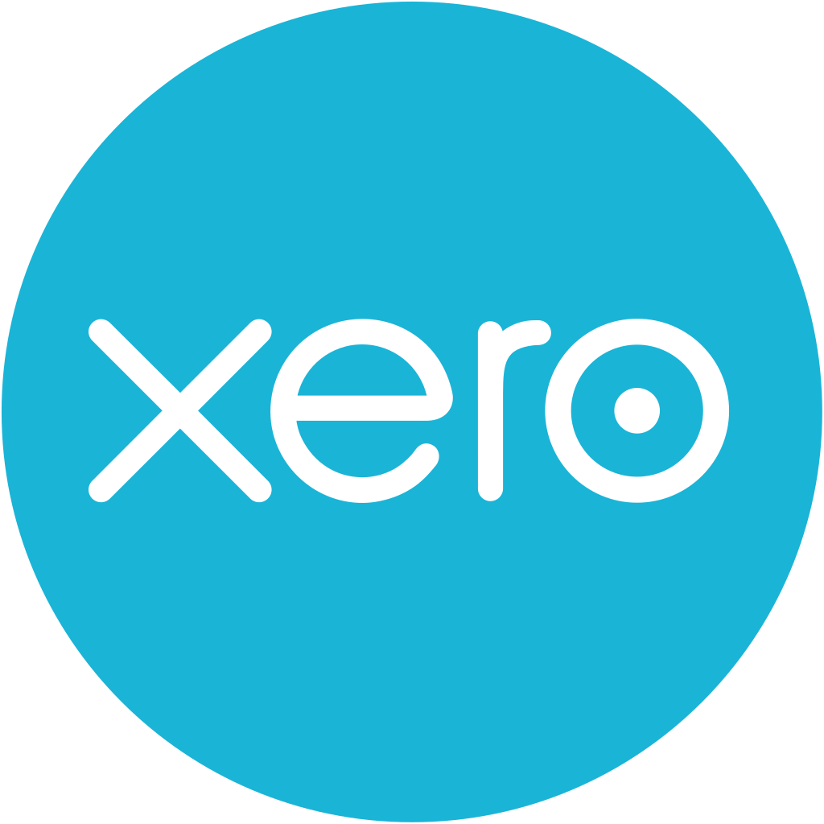
Customer Case Study – Xero (2015)
Explicit proxy
ProxyUrl": "http://proxy.internal:8080
Static routing
Spoke route table
172.16.0.0/23
pcx-xxxxx
Egress route to the Internet
Proxy Cluster
0.0.0.0/0
igw-xxxxx
Internal
Internal routes for transit
VPC A
10.1.0.0/16
pcx-xxxxx
External
VPC B
10.2.0.0/16
pcx-xxxxx
Security inspection services
Threat Protection Zone (TPZ) VPC
Notes:
During a nine month period in 2016, Xero migrated to Amazon Web Services. The migration involved moving 700,000 customers who process more than ]$1 trillion worth of transactions per annum.
But in 2015, the Network and Security team at Xero worked closely with AWS and enterprise security partners (such as Check Point, Imperva etc.) to establish the Threat Protection Zone (or TPZ) which was based on a hub / spoke, transit VPC-style architecture (before Transit VPC was an established pattern).
The design of the TPZ was that inbound, outbound and cross region traffic should be routed to product VPCs. Initially, 5 TPZ’s were deployed across 3 AWS regions.
TPZs were deployed in a multi AZ configuration and contained the following services:
Inbound Web Application Firewall
Application and URL Filtering, IPS (Intrusion Prevention System), Antivirus and Anti-malware
Primary issues issues with the TPZ architecture were the use of static routing and and explicit proxies.
Explicit proxies sometimes were difficult to configure, and didn’t easily support all services.
In order to scale, Xero needed to design a more flexible and modular version of the TPZ.

Slide 28
Customer Case Study – Xero Future State
Security inspection services
Security inspection services
Transit Gateway
TPZ ingress
TPZ Egress
Dynamic routing
Notes:
Xero has grown to service over 1.6 million subscribers, who have transacted over 2.15 trillion dollars across the platform in the year to 31st March 2018.
With this new growth comes new needs and opportunities for Xero and the network and security team are working with AWS and its security partners to develop new architectural patterns that allow its infrastructure to be more flexible and modular.
This new design has the following benefits:
No More Explicit Proxy!
Dynamic Routing!
All security services, ingress, egress and cross product were supported in a modular and flexible manner.
Using this design we simply add as many environments as needed to support growth, share our resources across logical boundaries and build a truly decoupled network / security architecture.
The Network and Security teams Xero has been working with AWS and Check Point through out the beta phase to first design and then deploy this new architecture with great success.

Slide 29
AWS Transit Gateway: Pricing
Fixed Fee: per hour or partial hour that your Transit Gateway is running in your account
Data Transfer Fee: Rate per GB of data transferred

Slide 30
Questions?

Slide 31
What is Route 53 Resolver?

Slide 32

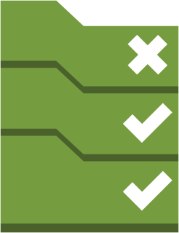
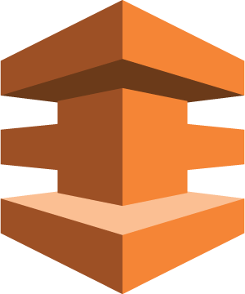
Route 53 Resolver
Managed DNS Resolver service from Route 53
Create conditional forwarding rules to re-direct query traffic
Enables hybrid connectivity over AWS Direct Connect and Managed VPN

Slide 33
What challenges does it solve?

Slide 34




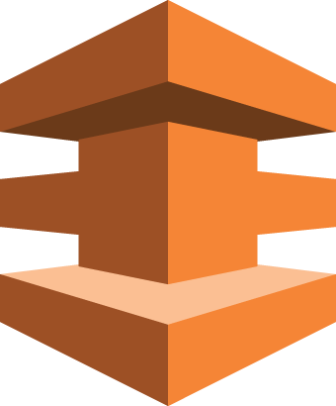

Enabling Hybrid Cloud
Data Center
VPC
Account 1

Slide 35
Enabling Hybrid Cloud
Data Center
VPC
X
Account 1

Slide 36
Enabling Hybrid Cloud
Data Center
VPC
X
Account 1

Slide 37
Enabling Hybrid Cloud
Data Center
VPC
Account 1

Slide 38
Enabling Hybrid Cloud
Data Center
VPC
Account 1

Slide 39
Enabling Hybrid Cloud
VPC
Data Center
Account 3
VPC
VPC
Account 1
Account 2

Slide 40
Enabling Hybrid Cloud
VPC
Data Center
Account 3
VPC
X
VPC
Account 1
Account 2

Slide 41
Enabling Hybrid Cloud
VPC
Data Center
Account 3
VPC
VPC
Account 1
Account 2

Slide 42
Enabling Hybrid Cloud
VPC
Data Center
Account 3
VPC
VPC
Account 1
Account 2

Slide 43
How does Route 53 Resolver Solve This?

Slide 44
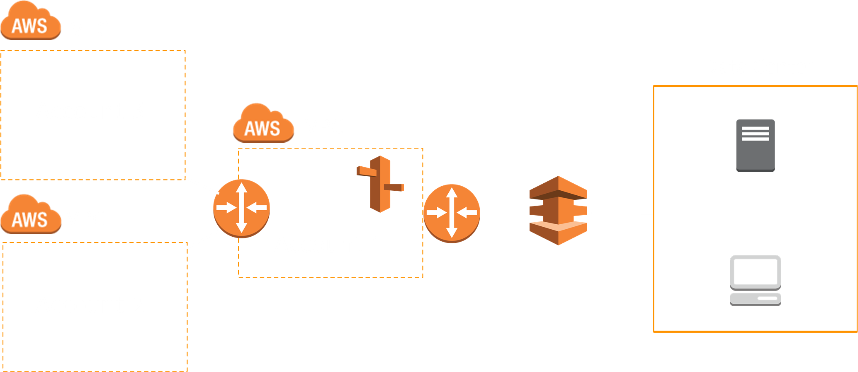

Route 53 Resolver

Slide 45
Route 53 Resolver

Slide 46

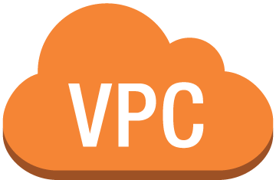

Route 53 Resolver Endpoint
VPC Subnet
IP Address
Availability Zone
VPC Subnet
IP Address
Availability Zone

Slide 47
Benefit to you: Reduced Complexity
VPC
Data Center
Account 3
VPC
VPC
Account 1
Account 2

Slide 48
Benefit to you: Reduced Complexity
VPC
X
Data Center
Account 3
X
VPC
VPC
X
Account 1
Account 2

Slide 49
Benefit to you: Reduced Complexity
VPC
Data Center
Account 3
VPC
VPC
Account 1
Account 2

Slide 50
Benefit to you: Reduced Complexity
100
1
DNS Forwarders
Endpoint

Slide 51
Benefit to you: Availability
Use AWS high availability architecture
Create additional redundancy by provisioning more ENIs in different AZs
VPC
Account 1

Slide 52
Benefit to you: Maintain VPC-specific answers
VPC
First check if rules apply
If not, resolve locally to VPC
1
2
Account 1

Slide 53
Benefit to you: Eliminate Bottlenecks
VPC
Data Center
Account 3
VPC
VPC
Account 1
Account 2

Slide 54
Benefit to you: Cross Account Rules Sharing
VPC
Managed rules in one account
Share with any other account
Resource Access Management(RAM) uses AWS Organizations to share rules with other accounts
Account 3
VPC
VPC
Account 1
Account 2

Slide 55
Benefit to you: Cross Account Rules Sharing
VPC
Managed rules in one account
Share with any other account
Resource Access Management(RAM) uses AWS Organizations to share rules with other accounts
Account 3
VPC
VPC
Account 1
Account 2

Slide 56
Benefit to you: Cross Account Rules Sharing
VPC
Managed rules in one account
Share with any other account
Resource Access Management(RAM) uses AWS Organizations to share rules with other accounts
Account 3
VPC
VPC
Account 1
Account 2

Slide 57
How do I get started?

Slide 58
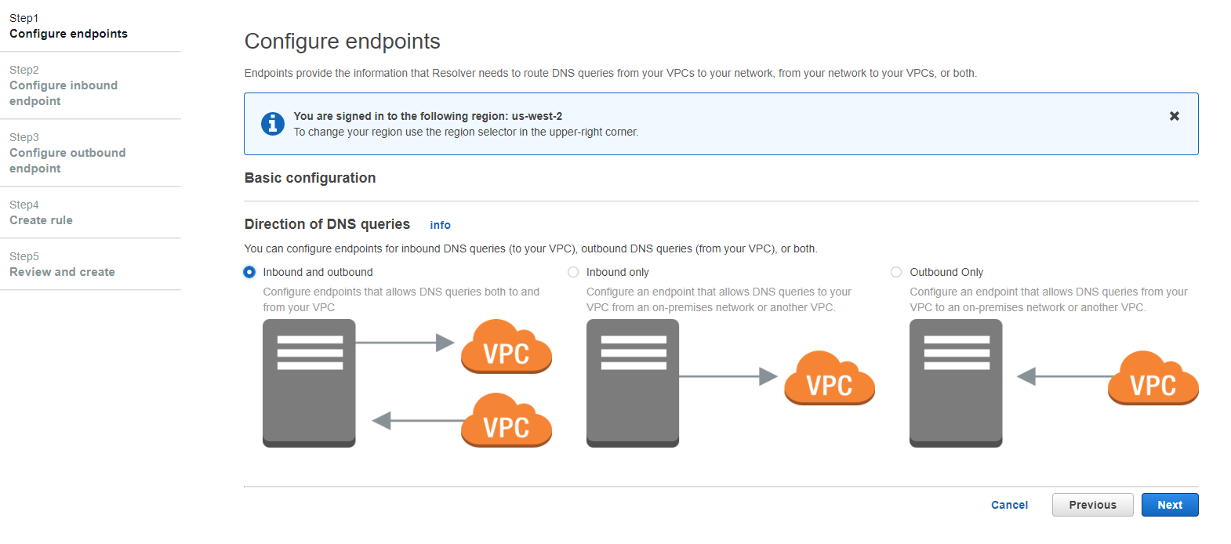
Console: Step 1 Choose Endpoints

Slide 59
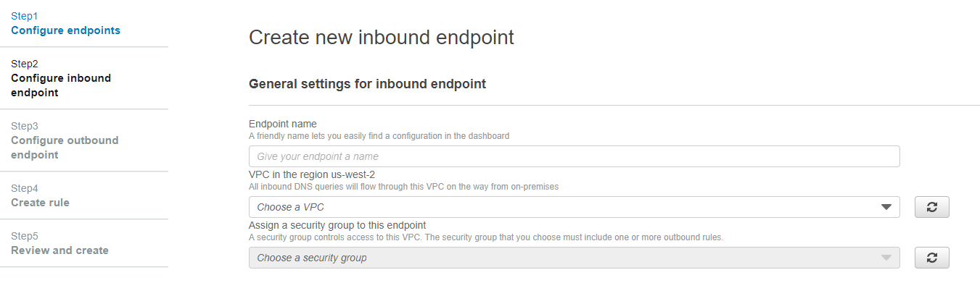
Step 2: Configure Endpoint

Slide 60
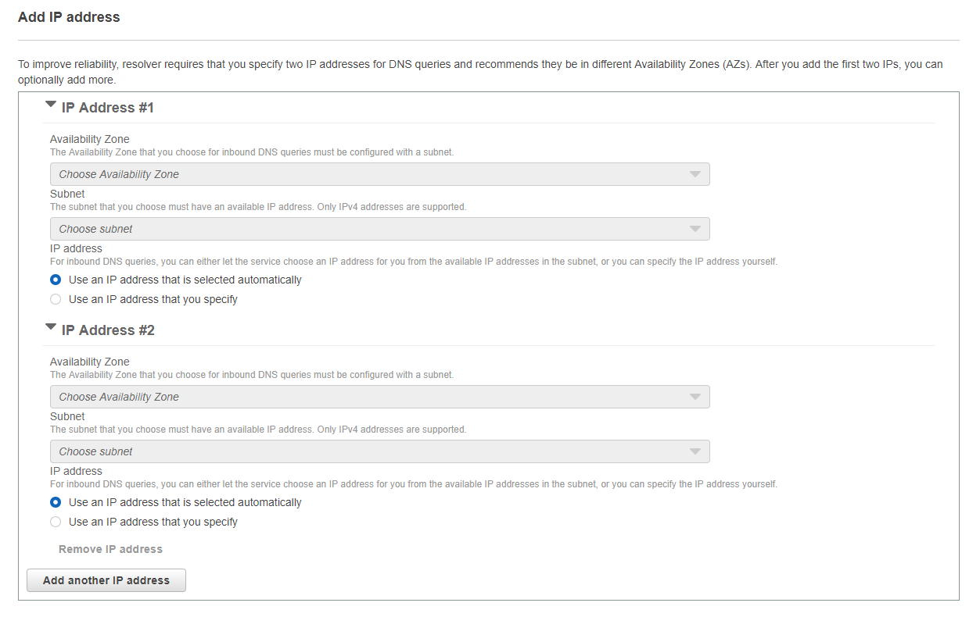
Step 2: Configure Endpoint

Slide 61
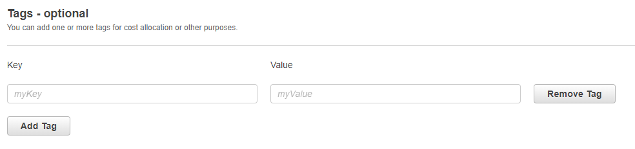
Step 2: Configure Endpoint

Slide 62
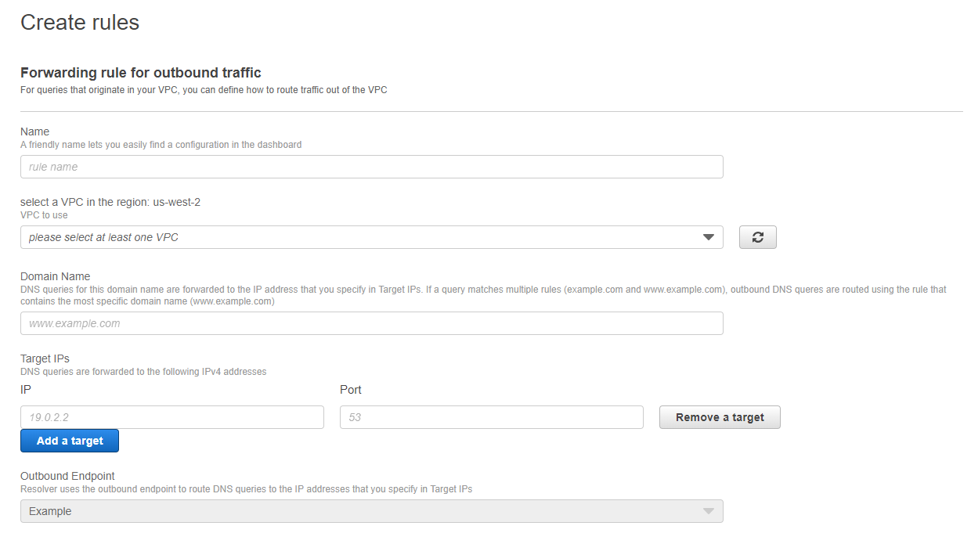
Step 3: Create Rules

Slide 63
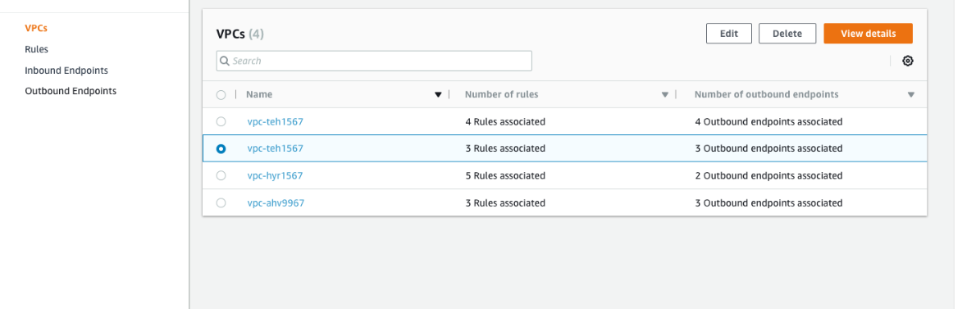
Step 4: Redirected to VPC Dashboard

Slide 64



Resolver Rules
Current query processing
Example:
Create an instance within a VPC with
enableDnsSupport & enableDnsHostnames set true.
169.254.169.253
Route 53 Resolver
VPC Names
x.x.x.2
Private Hosted Zones
Internet Resolver
Autodefined Rules

Slide 65
Resolver Rules
169.254.169.253
Add an inbound resolver endpoint
Example:
Provide on-premises data centers resolution for a Private Hosted Zone.
Route 53 Resolver
VPC Names
x.x.x.2
Private Hosted Zones
Inbound Endpoint
Internet Resolver
Autodefined Rules

Slide 66
Resolver Rules
VPC Names
169.254.169.253
Resolver Rules allow controlling the resolution path for a domain.
System Resolver Rule directs queries down the default resolution path.
Route 53 Resolver
Private Hosted Zones
x.x.x.2
Inbound Endpoint
Internet Resolver
Outbound Endpoint
Autodefined Rules
Resolver Rule #1
Resolver Rule #2

Slide 67
Resolver Rules Processing
Customer Defined
System
Domain: “.”
RuleType: FORWARD
TargetIp: 1.1.1.1:53 ( ns.mycompany.com )
Domain: “.”
RuleType: RECURSIVE (internet)
<< Autodefined Rules >>
ec2.internal, compute.internal, Private Hosted Zones
Autodefined Rules
Private Hosted Zones
VPC names (ec2.internal, …)
Query: website.onprem.mycompany.com

Slide 68
Resolver Rules Processing
Customer Defined
System
Domain: “.”
RuleType: FORWARD
TargetIp: 1.1.1.1:53 ( ns.mycompany.com )
Domain: “.”
RuleType: RECURSIVE (internet)
<< Autodefined Rules >>
ec2.internal, compute.internal, Private Hosted Zones
Autodefined Rules
Private Hosted Zones
VPC names (ec2.internal, …)
Query: ip-10-10-10-10.ec2.internal

Slide 69
Resolver Rules Processing
Customer Defined
System
Domain: “.”
RuleType: FORWARD
TargetIp: 1.1.1.1:53 ( ns.mycompany.com )
Domain: “.”
RuleType: RECURSIVE (internet)
<< Autodefined Rules >>
ec2.internal, compute.internal, Private Hosted Zones
Autodefined Rules
Private Hosted Zones
VPC names (ec2.internal, …)
Domain: “acquiredcompany.com”
RuleType: FORWARD
TargetIp: 2.2.2.2:53 ( ns.acquiredcompany.com )
Query: website.acquiredcompany.com

Slide 70
API
CreateResolverEndpoint
Create an inbound endpoint
Create an outbound endpoint
CreateResolverRule
Forward queries for a domain to an IP address by an endpoint
AssociateResolverRule
Link a resolver rule to a VPC
PutResolverRulePolicy
Allow a resolver rule to be shared with another account

Slide 71
Sample CLI Commands
aws route53resolver create-resolver-endpoint
--creator-request-id 1
--name inbound-test
--direction INBOUND
--security-group-ids sg-12345678
--ip-addresses "SubnetId=subnet-88888888" "SubnetId=subnet-cccccccc”
aws route53resolver create-resolver-endpoint
--creator-request-id 2
--name outbound-test
--direction OUTBOUND
--security-group-ids sg-12345678
--ip-addresses "SubnetId=subnet-88888888" "SubnetId=subnet-cccccccc”

Slide 72
Sample CLI Commands
{
"Version": "2012-10-17",
"Statement": [ {
"Effect" : "Allow",
"Principal" : {"AWS" : [ "222222222222" ] },
"Action" : [
"route53resolver:GetResolverRule",
"route53resolver:AssociateResolverRule",
"route53resolver:DisassociateResolverRule",
"route53resolver:ListResolverRules",
"route53resolver:ListResolverRuleAssociations" ],
"Resource" : [
"arn:aws:route53resolver:<region>:<account-id>:resolver-rule/<rule-id>"
] } ] }
aws route53resolver create-resolver-rule
--creator-request-id 1
-–rule-type FORWARD
--domain-name onprem.mycompany.com
--target-ips "Ip=172.1.1.1"
–-resolver-endpoint-id rslvr-out-xxxx
aws route53resolver associate-resolver-rule
--name onprem-rule
--resolver-rule-id rslvr-rr-xxx
--vpc-id vpc-xxxx
aws route53resolver put-resolver-rule-policy
--arn onprem-rule-arn
--resolver-rule-policy <policy>

Slide 73

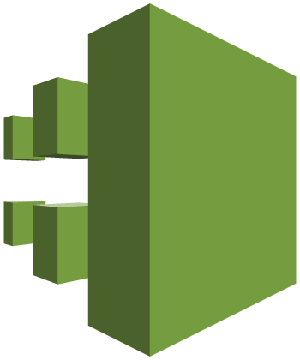
Metrics & Monitoring
Amazon CloudWatch
Track queries per second in / out of a resolver endpoint
AWS CloudTrail
Track API calls & usage

